Slide 1
Seattle Traffic Collisions and Causes

Slide 2
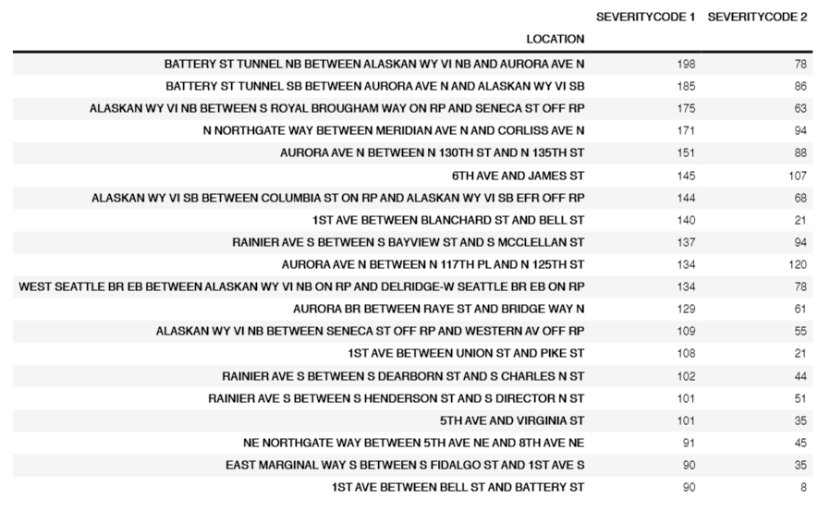
Data analysis
Top 20 locations of crashes

Slide 3
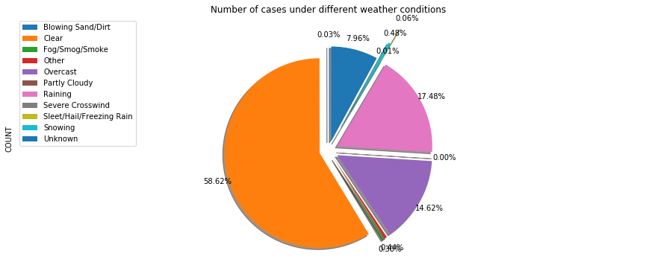
Data analysis
Summary of collision weather data

Slide 4
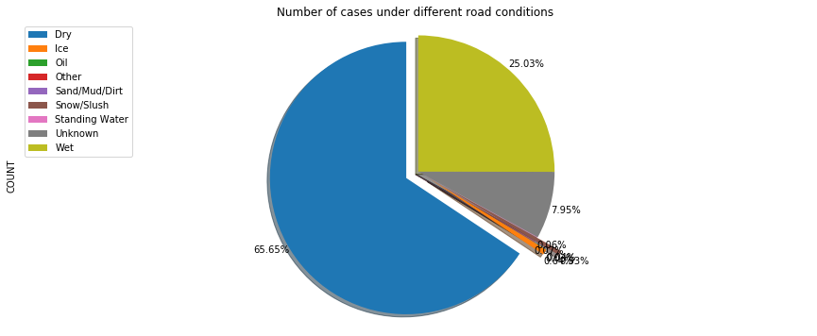
Data analysis
Summary of collision road condition data

Slide 5
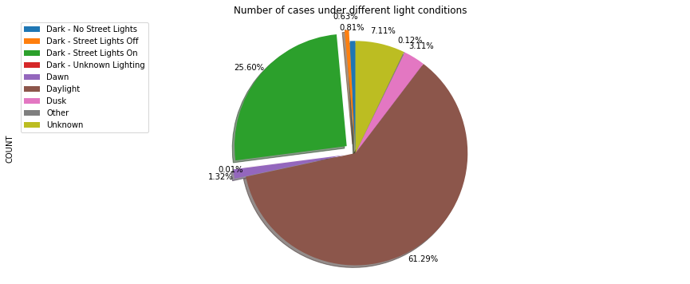
Data analysis
Summary of collision light condition data

Slide 6
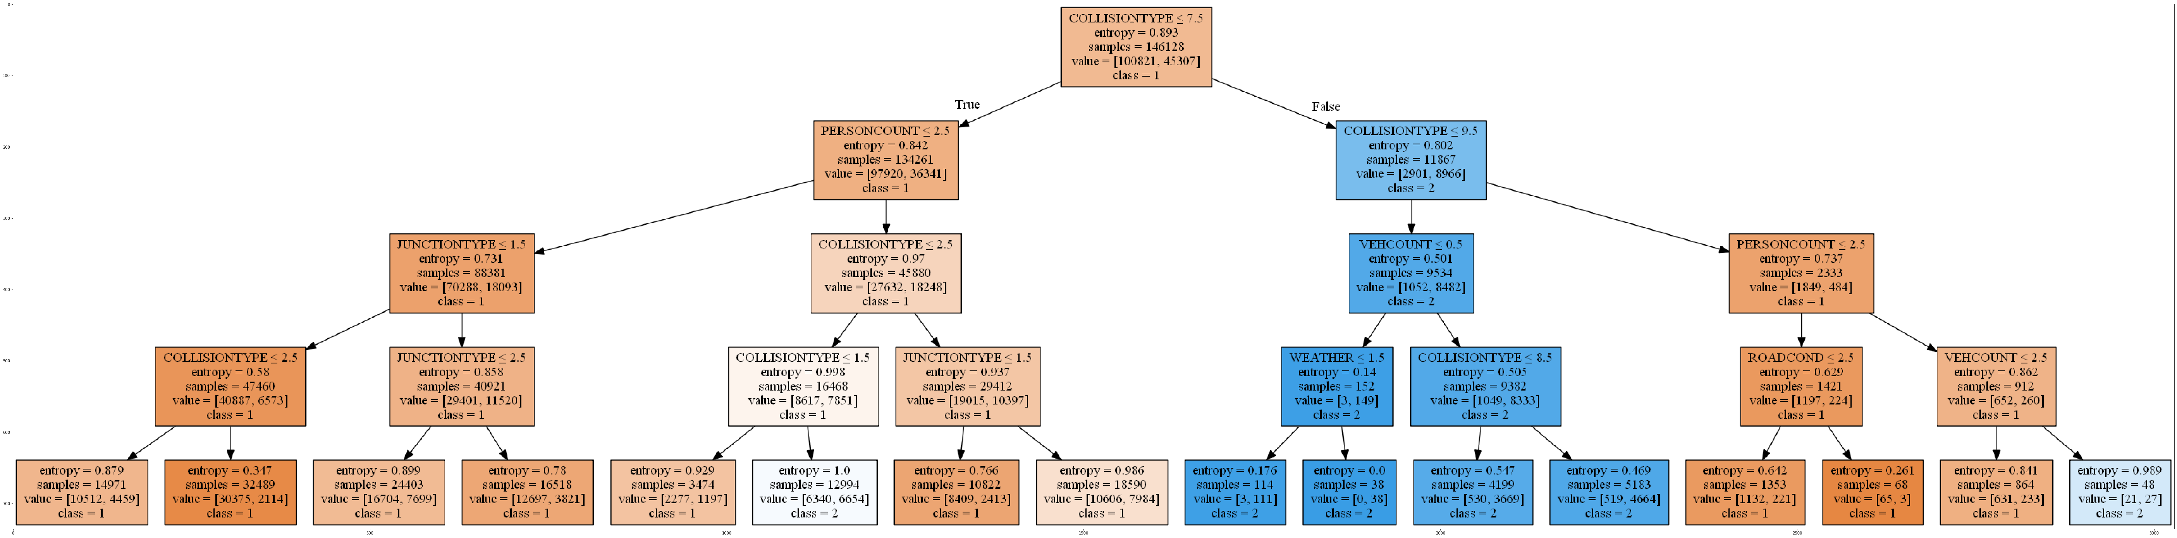
Decision tree

